Slide 1
Day 1 PPT Introduction to Signals & Images
Summary
Presented By-
V.Megha Saran

Slide 2
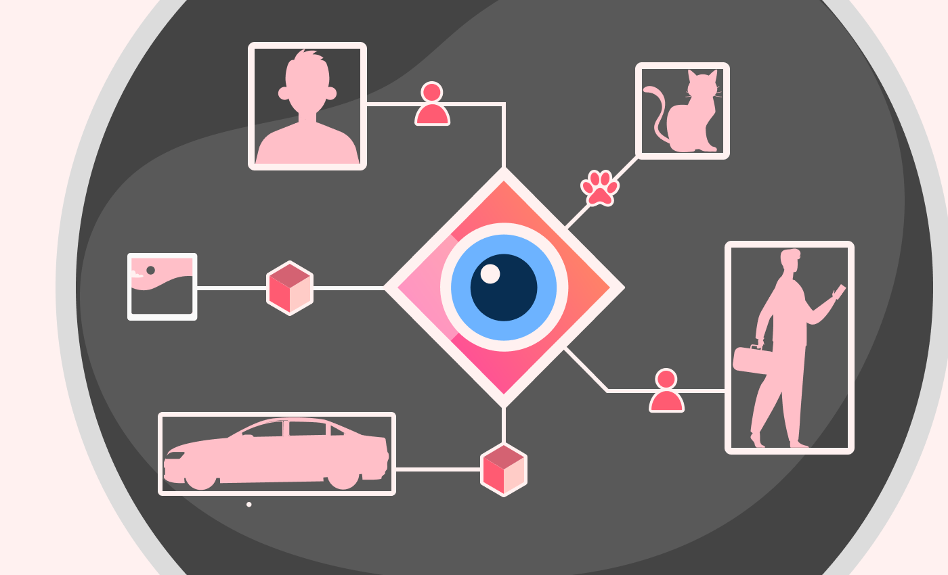
Visual Intelligence
Visual intelligence refers to the ability of a system (like a computer or a robot) to understand and interpret visual information from the world, much like humans do with their eyes and brain. It involves recognizing objects, people, scenes, and activities in images or videos, and making sense of them to perform tasks or make decisions.
Computer Vision is the technology and methods used to achieve visual intelligence in machines.

Slide 3
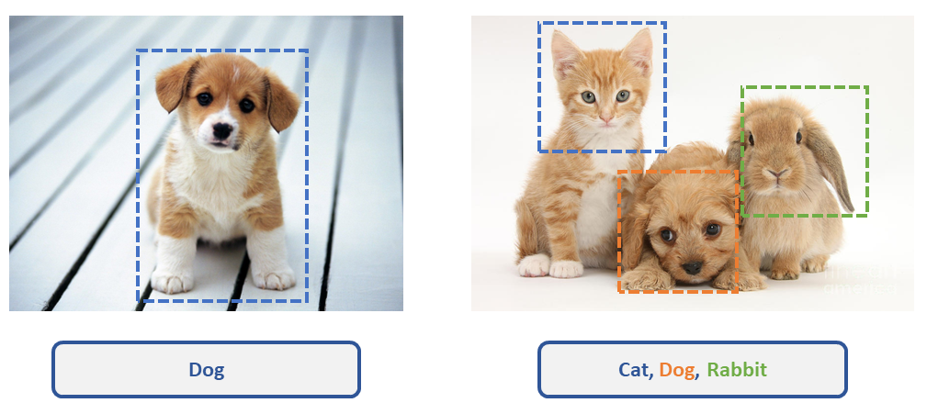
Levels of Granularity
Image processing can be done at various granularity levels –
Image Processing
Object Detection
Semantic Segmentation
Instance Segmentation
Instance Segmentation
Image Classification
This task involves assigning a single label to an entire image. It identifies what main object or category the image belongs to.

Slide 4
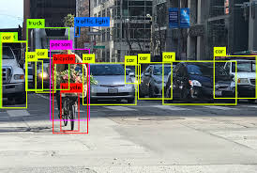
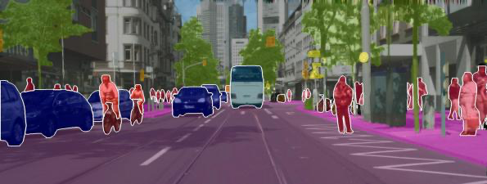
Object Detection
Semantic Segmentation
It not only classifies the objects but also provides bounding boxes around each object to show their positions.
It involves labeling each pixel of an image with a class, providing a detailed map of the image. It not only detects objects but also distinguishes boundaries at the pixel level.

Slide 5
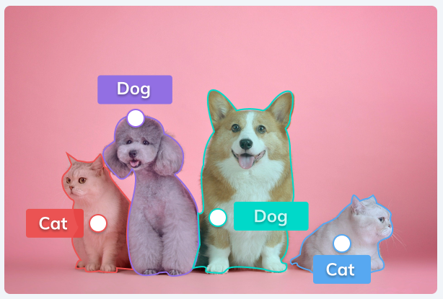
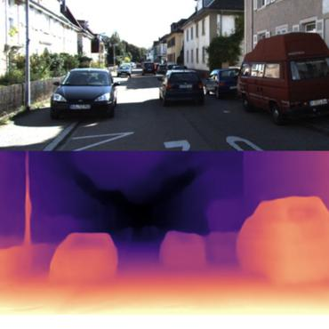
Instance Segmentation
This task combines object detection and semantic segmentation. It not only labels each pixel with a class but also differentiates between different instances of the same class.
Different Instances of the same class ‘Dog’
Depth Estimation
Determines the distance of objects or surfaces in the scene from the camera. It creates a depth map that shows how far each part of the image is from the viewpoint.

Slide 6
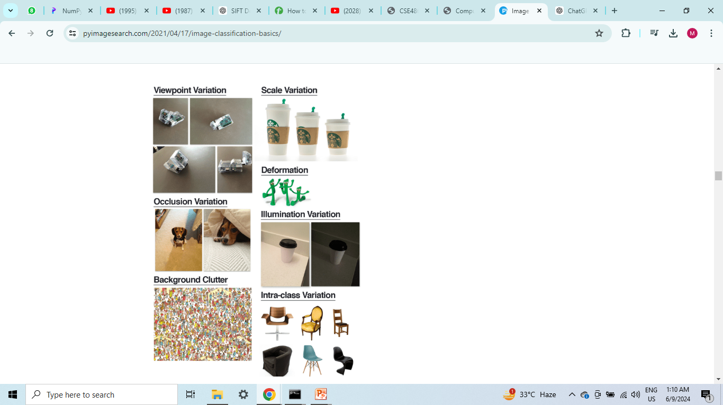

CHALLANGES
CHALLANGES

Slide 7
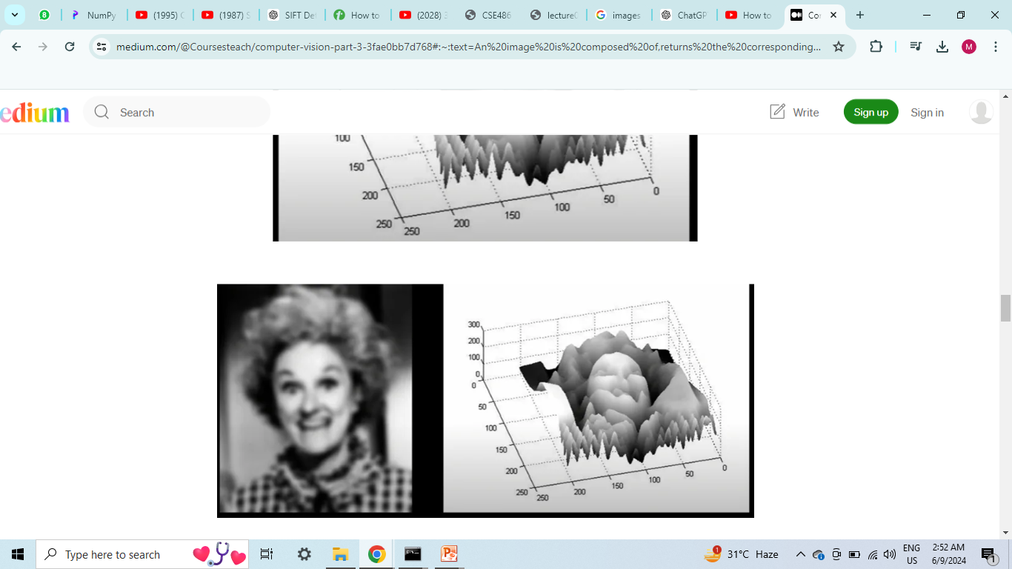
Images as Surfaces
How is image a function??
Images are essentially surfaces with points having x and y coordinates. The value at a point depends on (x,y) coordinates. Thus an image can be represented as a function f(x,y).
How to store an image??
B-Spline Matrix: B-Splines are piecewise polynomial functions used for approximation and interpolation of data.

Slide 8
What is the issue with B-Spline??
Computational Complexity: B-Spline calculations involve solving polynomial equations, which is computationally intensive.
A better way to store images in computer is to do so using 2D matrices(for grayscle images) and 3D(m,n,3)matrix for colored images.
Sampling
Sampling : Sampling is the process of converting a continuous image signal into a discrete signal
Quantization : Quantization is mapping the continuous range of pixel values into a finite range of discrete values.
Encoding : Encoding is the process of converting the quantized pixel values into a format that can be easily stored or transmitted.
Quantization
Encoding

Slide 9
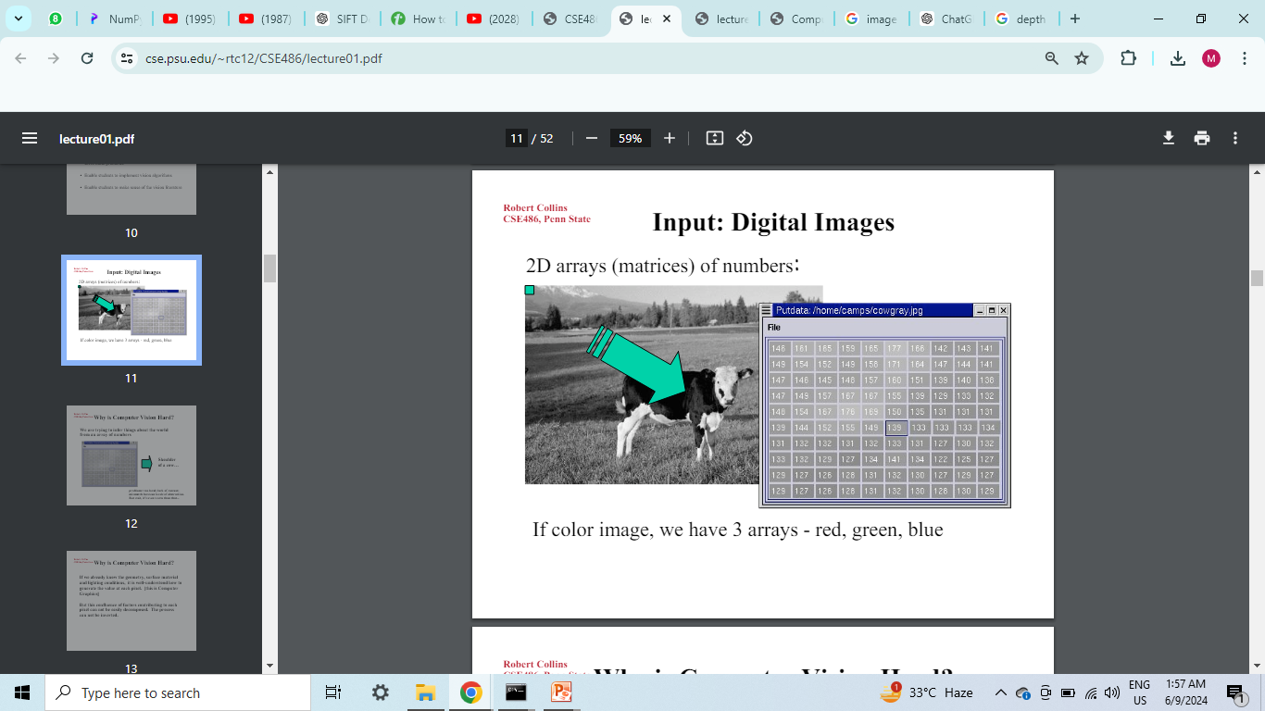
Image Formation
The standard quantisation has 256 levels(0-255).
Every sampling Point in the image is called a Pixel.
The total number of pixels is called Resolution.
The more the sampling,more is the details in image, and bigger is the matrix.
When a light ray falls on an object, reflects from it and then falls on a film or a screen, it forms an image.

Slide 10
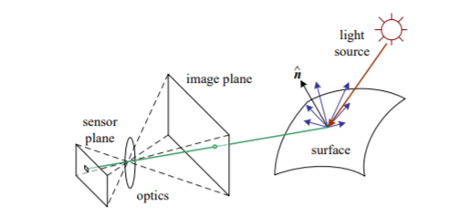
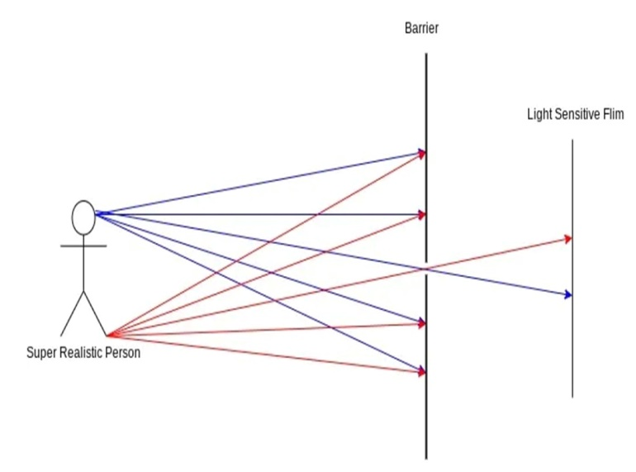
Some models were used to make a clear image of the object-
Pin-hole model
Aperture model
Lens model
Depth of Field(DOF): The range in which an object is limited be placed, in order to have a clear and bright image.
Field of View(FOV): Describes the viewable area that can be imaged by lens system.

Slide 11
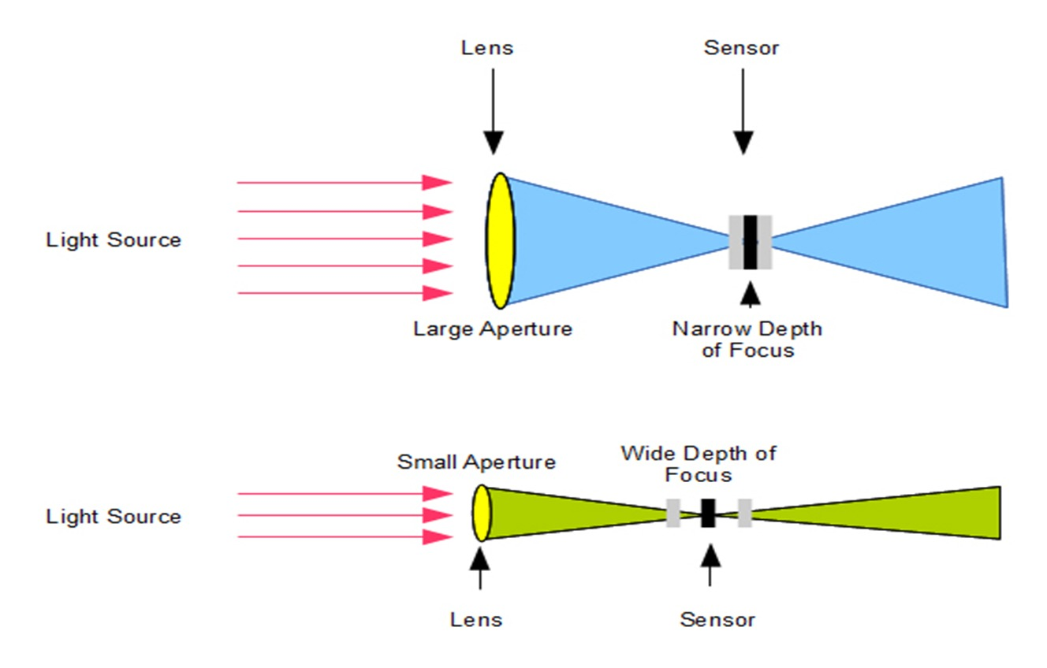
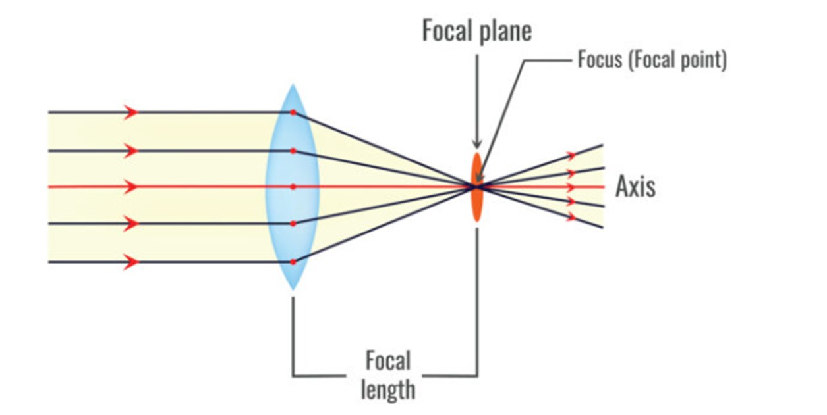
Relation b/w DoF and size of apperture
Lens Model

Slide 12
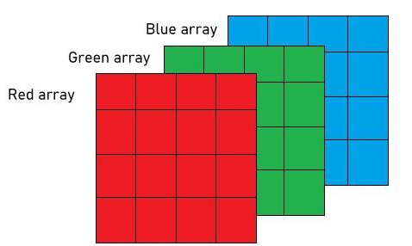
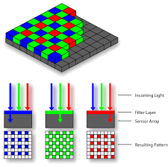
How are colored images stored?
Colored images are stored in the form of a 3D matrix or Triplet Matrix of size m×n×3. Each color makes a layer. One such model is the RGB model.

Slide 13

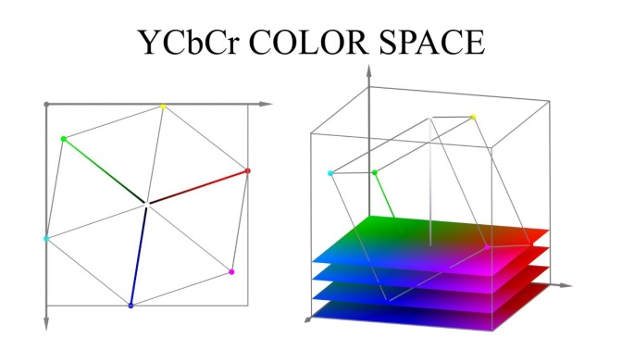
YCbCr Model It separates the image into luminance (Y) and chrominance (Cb and Cr) components. The Y component represents the brightness of the image, while Cb and Cr represent the blue-difference and red-difference chroma components, respectively.

